Slide 1
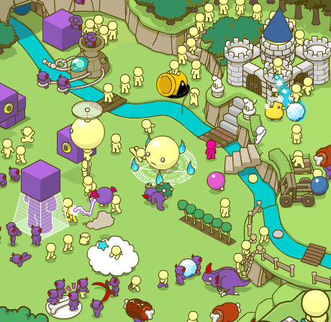
Microservices Patterns
Harsh Seth
https://twitter.com/ha_seth

Slide 2

Patterns
Reusable solution to a problem that occurs in a specific context.
Useful in S/W architecture and designing
Context

Slide 3
Architecture Patterns

Slide 4
Context

Slide 5
Context Explanation
600K line software running in production.
X teams are working in it.
Development is slow.
Pushing changes in production takes time.
Scaling issues
Less reliability
Difficult to change technology.

Slide 6
Forces
Multiple teams can work
Code is easy to understand and modify
Continuous deployment
Scalable
And available
Emerging and better technologies.
Quickly developer should be productive

Slide 7
1. Microservice Architecture Pattern
Better maintainability.
Fast deployment of a service.
Two pizza team can own one service.
Scalability and availability running multiple instances.

Slide 8
Issues
Decomposing the application
IPC between services
Queries spanning multiple services.
Troubleshooting from client’s perspective.
Transactional Updates

Slide 9
Decomposition Patterns

Slide 10
Context

Slide 11

Problem
Functional decomposition of application into service.
How big should be a service?

Slide 12
Forces
Stable Architecture
Cohesive
Loosely Coupled
Small

Slide 13
2. Decompose by business capability Pattern
Split as business as domain.
Understanding business
Structure
Process
Area of expertise
How to add promotion functionality?
Add it within order management service.

Slide 14
3. Decompose by subdomain Pattern
Based on subdomains
Core
Supporting
Generic
How to add promotion functionality?
Create a new promotion service.

Slide 15
Decomposing Benefits
Stable architecture
Cross functional and organised
Cohesive and loosely coupled.
Technology independent

Slide 16
Status
Fixed underlying microservice architecture
Defined cohesive and loosely-coupled services.

Slide 17
Communication Patterns

Slide 18
Context
Service API’s
Collaboration
Between Services
Client and Service
Interaction Style
One-One / One-Many
Sync/Async

Slide 19
4. Remote Procedure Invocation (RPI)
Request/Response
Synchronous
One-One
Like REST or gRPC call.

Slide 20
Issues
Reduced Availability
It might be stuck forever to call the other service causing cascading failures.
No other kind of interaction:
notifications, request/async response, publish/subscribe, publish/async response

Slide 21
5. Circuit Breaker Pattern
Fail fast if likely to fail
Monitor and handle failure for other service
Pseudocode:
States close, open and half-open.
Allow the requests if circuit is close.
If circuit is open, fail the request.
Wait for service to be up after which close the circuit.
Change states based on response from services.
https://github.com/haseth/spark

Slide 22
6. Messaging Pattern
Implements
Async Request Response
One-way Notifications
Publisher/Subscriber
Async API
Message Types and format
Channels
Broker Based architecture
RabitMQ
Apache Kafka

Slide 23
Message Infrastructure
It takes care of taking from input channel and putting to output channel.
Message could be of type event, command or query.
Loose Coupling between sender and receiver.

Slide 24
Benefits
Loose coupling
Improved Availability
More interaction style
Broker Complexity

Slide 25
Service Discovery Patterns

Slide 26
Context
GET /order-service/getOrders?

Slide 27

7. Service Registry Pattern
Register if service starts or stops.
De-Register if down/ crashed/ not available.
Services should periodically update registry with its current state.

Slide 28
8. Client Side Discovery

Slide 29
Explanation
Client queries the registry
Load balances the commands or queries
Coupling between client and registry
Service Discovery library on every client.

Slide 30
9. Server-Side Discovery

Slide 31
Explanation
Clients do not need to have service discovery logic.
High availability is required.
High Capacity as it would be bottler neck.
Ex. AWS Elastic Load Balancer

Slide 32
Querying Patterns

Slide 33
Context

Slide 34
10. API Composer

Slide 35
Explanation
Querying data from multiple services
findOrder()
findOrderHistory()
In-memory join in composer.
Difficult to get efficient implementation of queries with:
Filtering

Slide 36
11. Command Query Responsibility segregation (CQRS)
Segregation of concerns.
Command side DB (CRUD)
Efficient Query Side DB

Slide 37
Transaction Patterns

Slide 38
Context-1
Multiple services have its own DB.
Transaction within service is not difficult.
But we need to send transaction events atomically.
Like if order is received/updated/changed we need to update state and publish events to other services.

Slide 39
12. Transactional Outbox

Slide 40
Context-2
ACID transaction across multiple services.
Data consistency is required
If payment fails we need to revert transaction.

Slide 41
13. Saga Pattern
Sequence of local transactions.
Each local transaction updates its own database and sends resulting message/event to trigger the next local transaction.
If fails, saga performs certain compensation transactions to undo.
Coordination?

Slide 42
14. Orchestration Saga Pattern
Transactional Messaging
State Machine
Step | Service | Transaction | Compensating transaction
1 | Order Service | createOrder() | rejectOrder()
2 | Consumer Service | verifyConsumerDetails() | —
3 | Kitchen Service | createTicket() | rejectTicket()
4 | Accounting Service | authorizeCreditCard() | —
5 | Kitchen Service | approveTicket() | —
6 | Order Service | approveOrder() | —

Slide 43
Isolation ?
Atomicity, Consistency, Durability but not isolation
Dirty reads- Still not updated, Lost Updates- Cancel while processing.
Countermeasures:
Semantic Locks- Application level
Version File
Reread value

Slide 44
Observability Patterns

Slide 45
Context

Slide 46
15. Health Check API
Exposes health check API
Alerted if service instance fails
Request should be routed to working service.
Similar to Exception tracking Pattern.

Slide 47
16. Log Aggregation Pattern
Understand behavior of application.
Troubleshooting issues.
Alerts when certain message occurs in logs.

Slide 48
17. Distributed Tracing Pattern
Performance profiler in monolithic.
Request was handled by each of the service.
Add ID to every external request.
Instrumentation Library and distributed tracing server.

Slide 49
18. Application Metrics
Application Level or Infrastructure level metrics.
Name, value and timestamp.
Ex Prometheus

Slide 50
Thank You

